Slide 1
Guided Capstone:
Big Mountain Resort
Christopher Le

Slide 2
Problem Identification
Big Mountain Resort is a ski resort that accommodates about 350,000 customers every year.
The resort is serviced by 11 lifts, 2 T-bars, and 1 magic carpet for skiers.
The base elevation is 4,464 ft, and the summit is 6,817 ft with a vertical drop of 2,353 ft.
The resort recently installed a chair lift that increased operation costs by $1,540,000 this season.

Slide 3
Problem Identification
The resort's pricing strategy has been to charge a premium above the average price of resorts in its market segment.
Management knows there are limits to this pricing approach and suspects that Big Mountain is not capitalizing on its facilities as much as it could.
The business wants guidance on how to select a better value for their ticket price.
They are also considering a number of changes that they hope will either cut costs without undermining the ticket price or will support an even higher ticket price.

Slide 4
Recommendations & Key Findings
Scenario Options
Permanently closing down up to 10 of the least used runs. This doesn't impact any other resort statistics.
Increase the vertical drop by adding a run to a point 150 feet lower down but requiring the installation of an additional chair lift to bring skiers back up, without additional snow making coverage
Same as number 2, but adding 2 acres of snow making cover
Increase the longest run by 0.2 mile to boast 3.5 miles length, requiring an additional snow making coverage of 4 acres
Key Findings
Increase the ticket price from $81 to $85.34/day/customer and monitor the daily increase of revenue and validate with recent sale information.
Closing down one of the least used runs which may not have a direct impact on ticket price. However, closing a run would reduce the operational expenses, which in turn is added to the revenue.
Model suggests that increasing the vertical drop by 150 feet, adding a run, and installing an additional chair lift increase ticket price by $1.99/day/customer would increase the revenue.

Slide 5
Modeling Results
&
Analysis

Slide 6
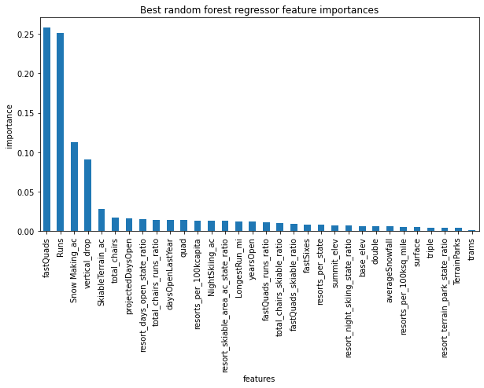
Top 15 Features using the Random Forest Regressor Model

Slide 7
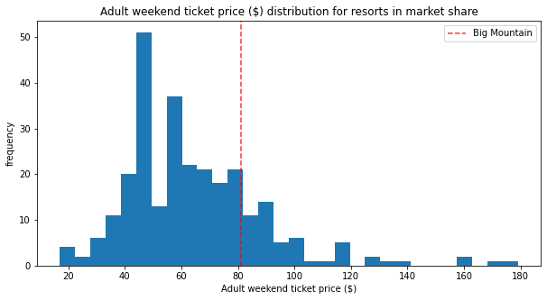
Big Mountain currently charges $81.00 for the ticket price. The calculated expected Big Mountain Ticket Price based on the model is $95.87 with a MAE of $10.39 if the ticket price was supported in the marketplace by Big Mountain’s facilities.

Slide 8
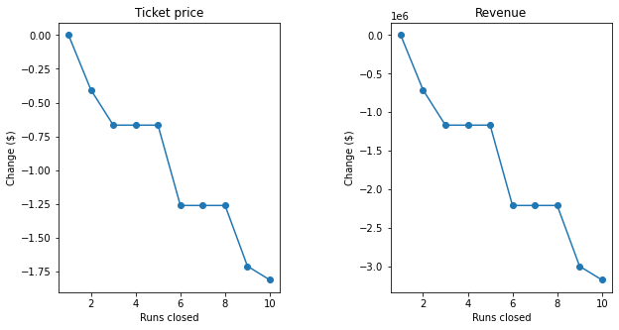
In scenario 2 where Big Mountain adds a run that increased the vertical drop by 150 ft while also installing an additional chair lift, the model suggests increased support for ticket price by $1.99. This is expected to amount to an increase revenue of $3,474,638 over the season.

Slide 9
Summary and Conclusions
Our model suggests a sizable room for an increase in ticket price since our resort might be undercharging.
Initially increase the ticket price from $81 to $85.34/day/customer and monitor the daily increase of revenue and validate with recent sale information. If it continues, increase the price to maximum of $106.40.
Add run that increases the vertical drop by 150 ft while also installing an additional chair lift: this would support increase ticket price by $1.99/day/customer and increase generated revenue by $3,474,638 over the season.
Reduce Operational Expenses: Closing down one of the least-used runs which may not have a direct impact on ticket price. However, closing a run would reduce the operational expenses, which in turn is added to the revenue. As the model suggests, recommend to close more least used runs after seeing the value gain of closing one.

